Slide 1
COMP2521 Week 3 24T3
Sorting Algorithms

Slide 2
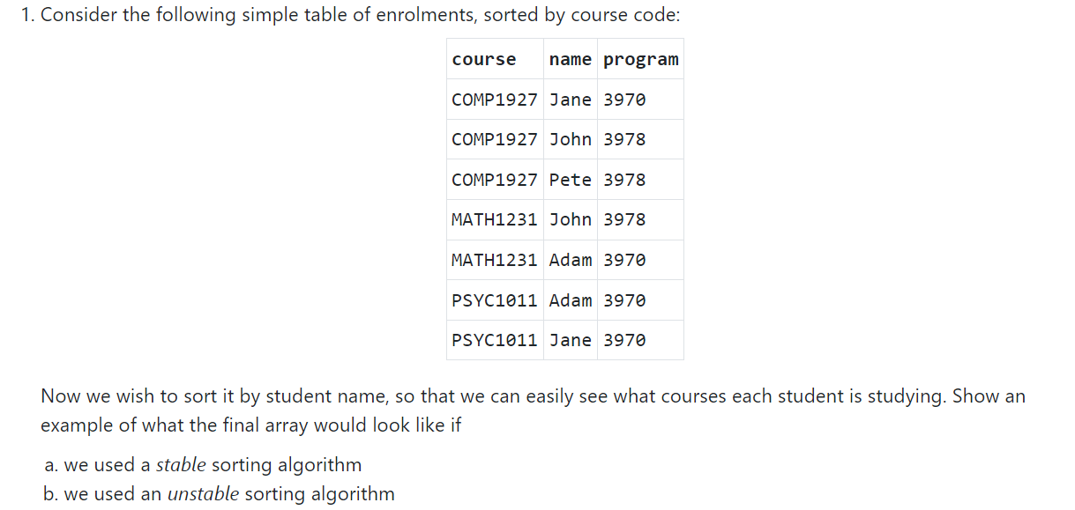
Q1

Slide 3
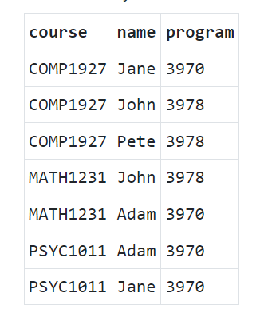
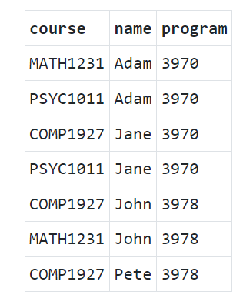
Q1 Answers (Stable Sort)

Slide 4
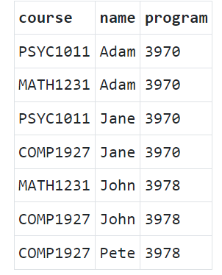
Q1 Answers (Unstable Sort)

Slide 5
Q2 Bubble Sort / Insertion / Selection Sort
- See code files

Slide 6
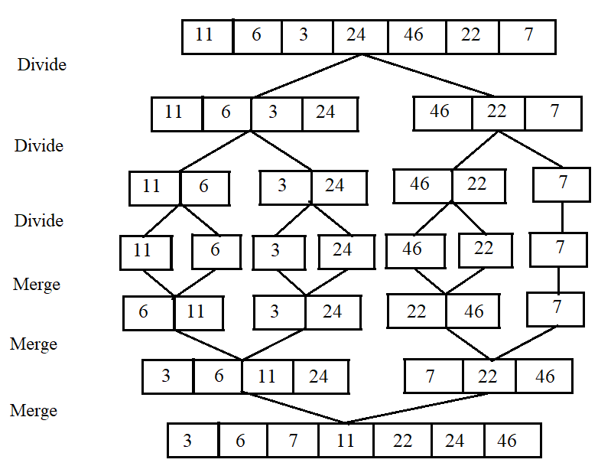
Merge Sort

Slide 7
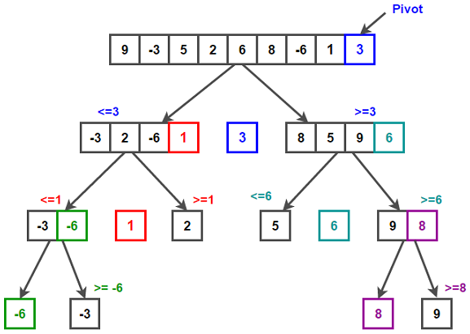
QuickSort

Slide 8
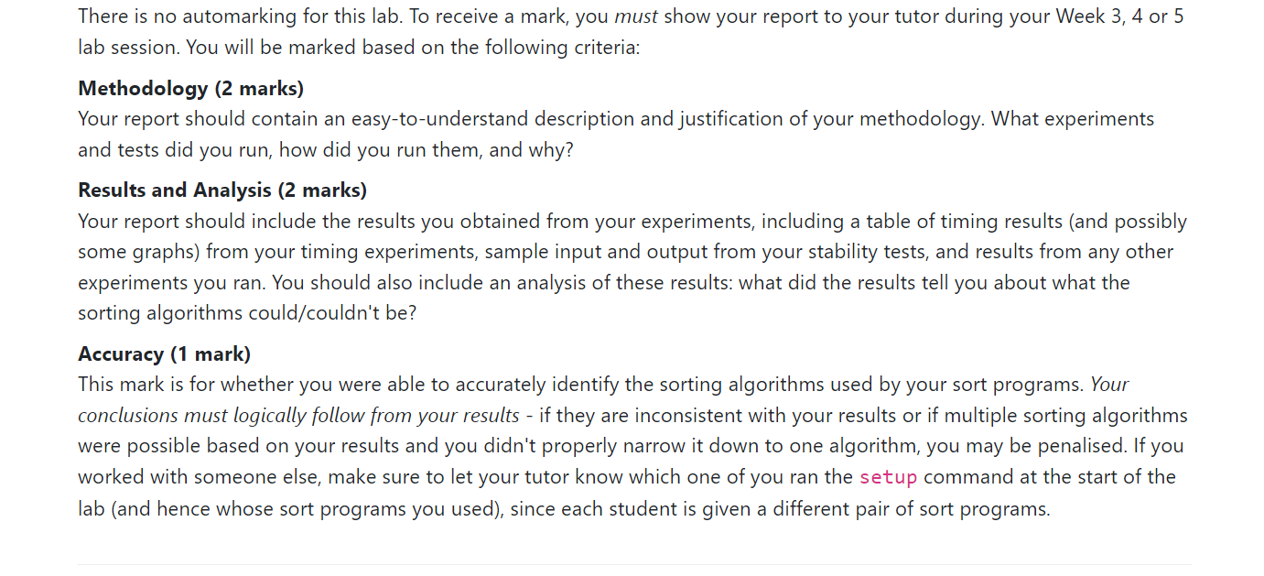
Lab 3

Slide 9
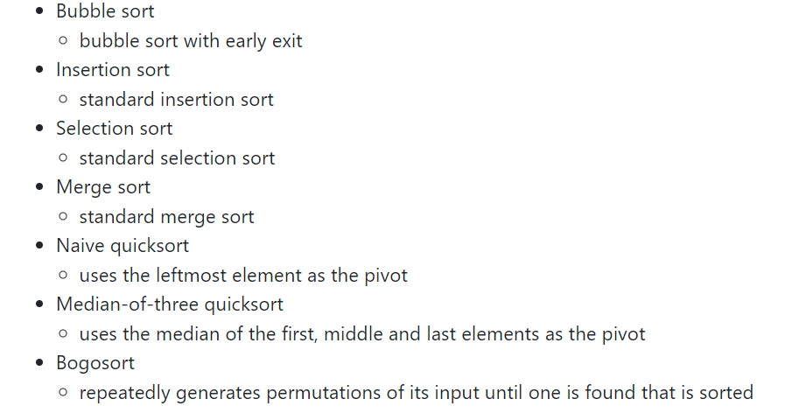
Methodology
You must be able to distinguish between every listed sort type!

Slide 10
Other tips & tricks
For all sorting algorithms, refer to implementation in lecture slides
Lab provides a script for timing sorts, modify the script for larger input sizes if the times are too small
Have a convincing and logical explanation for time complexities
“The graph looks like its O(n^2)” is not sufficient (how do I know its not nlogn)

